Slide 1
Allison Diploma in Website Development Using HTML and CSS
Certificate: Certificate of Completion from Allison
Skills Learned: Structuring web content with HTML, styling with CSS,
creating responsive layouts with Flexbox and CSS Grid,
adding images, custom fonts, animations, and interactive elements.
Outcome: Ability to build functional, professional,
and visually appealing websites from scratch.
Liya Hanan Thazhathethil noufal

Slide 2
HTML & CSS: Building Modern Websites
This presentation provides an in-depth overview of building modern websites using HTML and CSS. It covers the fundamental concepts of structuring web content with HTML, styling it with CSS, and creating professional layouts using tools such as Flexbox and CSS Grid. Additionally, it explores the use of custom fonts, responsive design through media queries, and interactive elements to enhance user experience.

Slide 3
Importance of HTML & CSS
HTML and CSS are the two foundational technologies of web development. HTML, or HyperText Markup Language, provides the structure and organization of content on a webpage. It defines elements such as headings, paragraphs, images, links, and forms, which give the page meaning and hierarchy. CSS, or Cascading Style Sheets, complements HTML by controlling the visual presentation of this content. It allows web developers to specify colors, fonts, spacing, and layout, transforming plain HTML into visually appealing websites. Both HTML and CSS are essential for creating any functional webpage.

Slide 4
Essential Skills for Web Designers
Building professional websites requires mastering several core skills. HTML5 introduces semantic elements and multimedia support, enabling more meaningful and structured web content. CSS3 allows developers to style websites effectively, including the use of animations and transitions to make web pages interactive. Flexbox provides a one-dimensional layout system for aligning elements horizontally or vertically, while CSS Grid offers a powerful two-dimensional system for arranging content in rows and columns. Additionally, selecting and applying custom fonts enhances readability and aesthetic appeal, giving the website a professional look.

Slide 5
Understanding HTML
HTML, or HyperText Markup Language, is the standard language used to create web pages. It consists of elements wrapped in tags that define the role of each piece of content. For example, headings are defined with <h1> to <h6> tags, paragraphs with <p>, and images with <img>. HTML allows developers to organize content in a logical and structured manner, providing the browser with the information it needs to display the content correctly. Without HTML, a web page would have no structure or meaning.

Slide 6
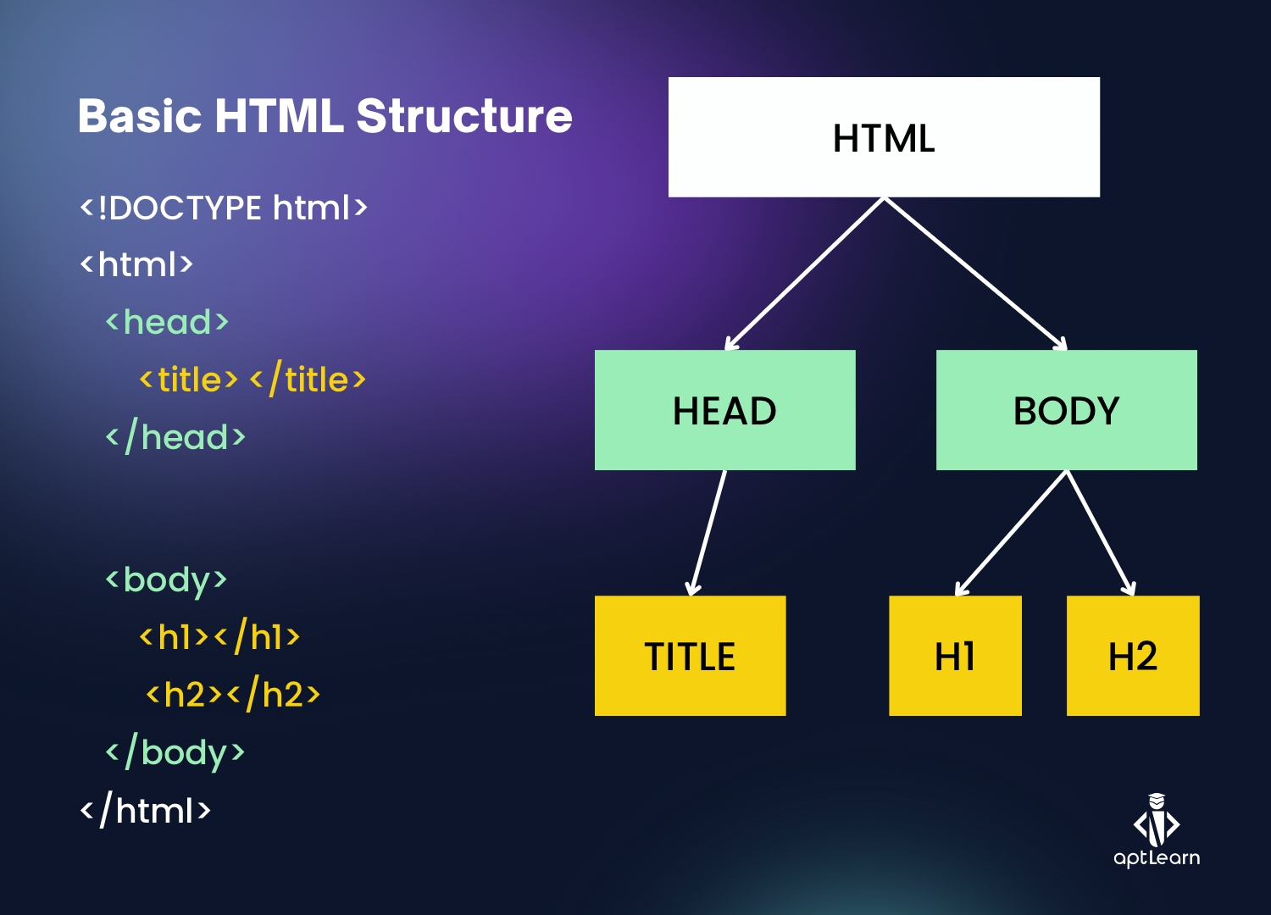
Structuring Content with HTML
HTML enables the semantic structuring of web pages using elements such as <header>, <main>, <section>, <article>, and <footer>. This structure ensures that content is organized logically and is easy to navigate for both users and search engines. A well-structured webpage improves usability, accessibility, and search engine optimization. For instance, a header contains navigation menus and the website title, the main section holds the primary content, and the footer can include author information and relevant links

Slide 7
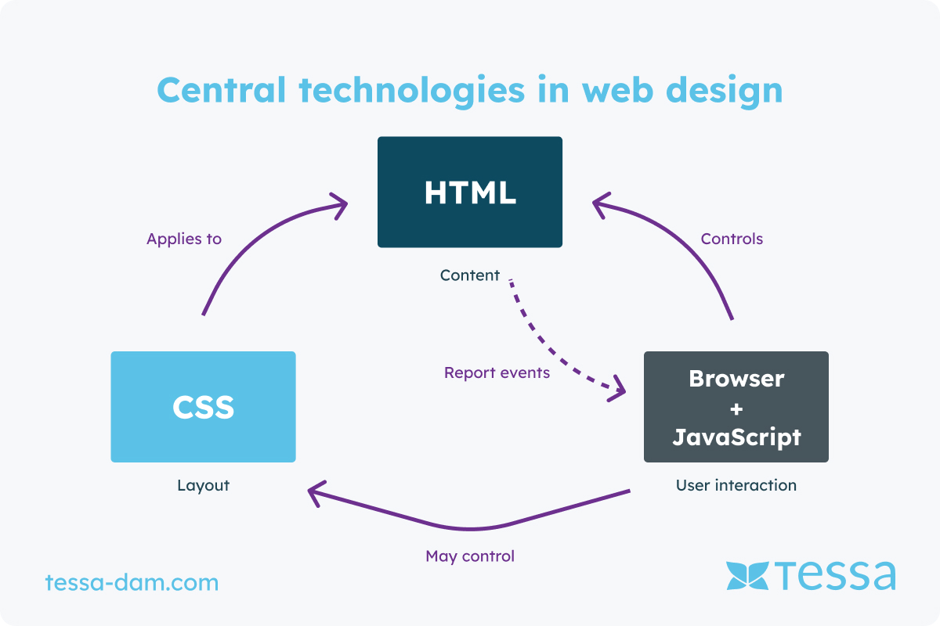
Understanding CSS
CSS, or Cascading Style Sheets, is used to style HTML content. While HTML defines the structure of a page, CSS defines how that structure appears visually. CSS allows developers to control color schemes, fonts, spacing, layout, and even animations, creating a visually appealing website. It can be applied inline, internally within the <style> tag, or externally through separate CSS files. By separating content and style, CSS makes it easier to maintain and update a website over time.

Slide 8
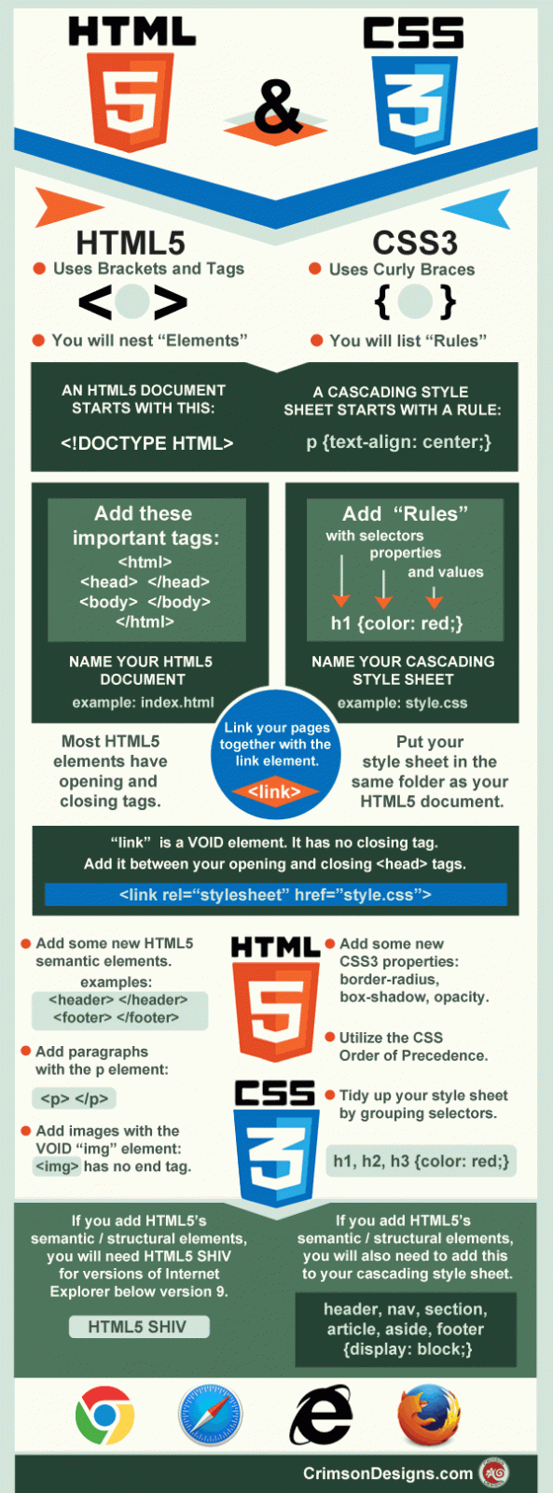
Role of CSS in Web Development
CSS plays a critical role in web development by transforming plain HTML into visually engaging websites. It allows designers to apply consistent styling across multiple pages and ensures that layouts remain structured and responsive on different devices. CSS supports animations and interactive effects, such as hover transitions on buttons or images, enhancing user experience. Additionally, responsive design techniques using CSS media queries enable web pages to adapt to different screen sizes, making them accessible and usable on desktops, tablets, and mobile devices.

Slide 9
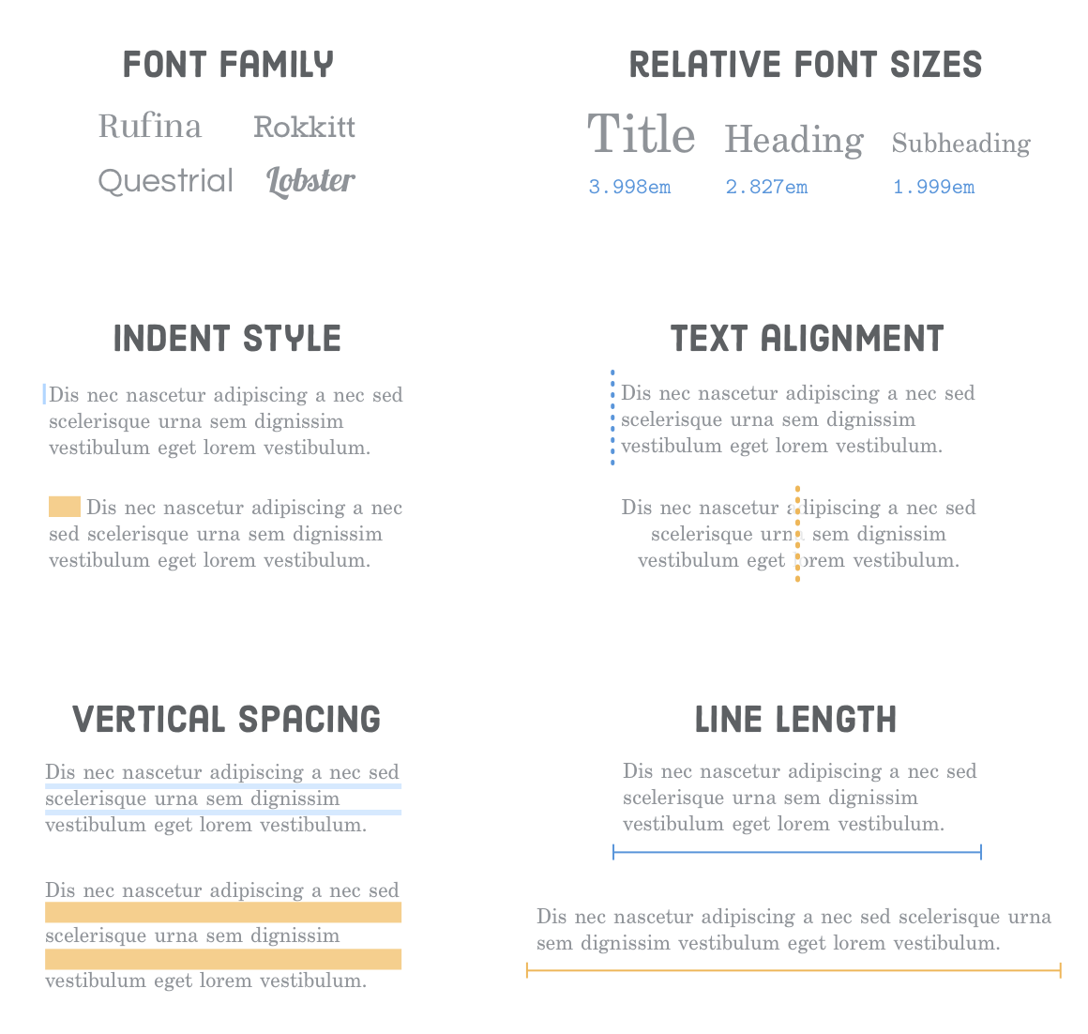
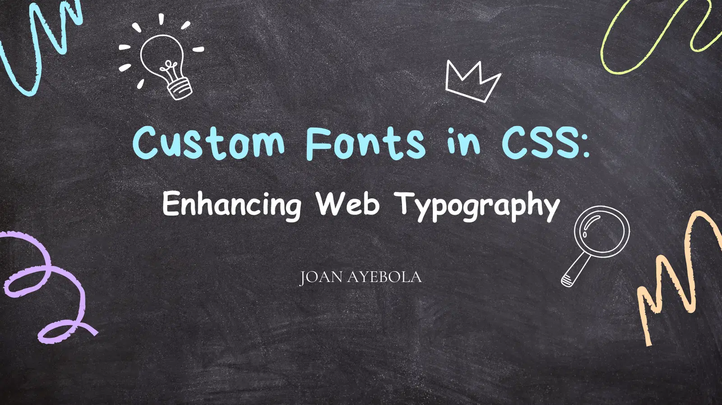
Custom Fonts & Typography
Custom fonts are a key component in defining the look and feel of a website. They improve readability and convey branding through style and tone. Fonts can be imported from services like Google Fonts or applied using the @font-face rule. Proper use of typography ensures that headings, paragraphs, and lists are visually organized, creating a harmonious and professional appearance. By combining fonts with CSS layout tools such as Flexbox and Grid, developers can align elements precisely and maintain consistency across the page.

Slide 10

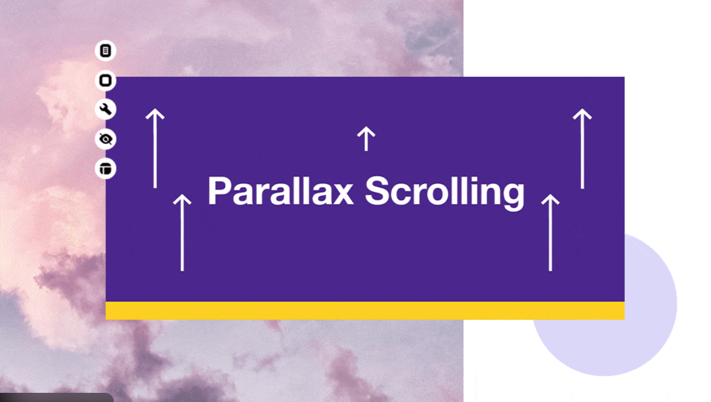
Adding Images and Parallax Effects
Images enhance the visual appeal of websites and can be added using the <img> tag or set as background images through CSS. The parallax effect is a popular design technique where the background moves slower than the foreground content, creating depth and a dynamic experience. Text overlays can be applied on parallax images to highlight important messages or headings. These visual techniques improve engagement and provide a professional aesthetic to modern websites.

Slide 11
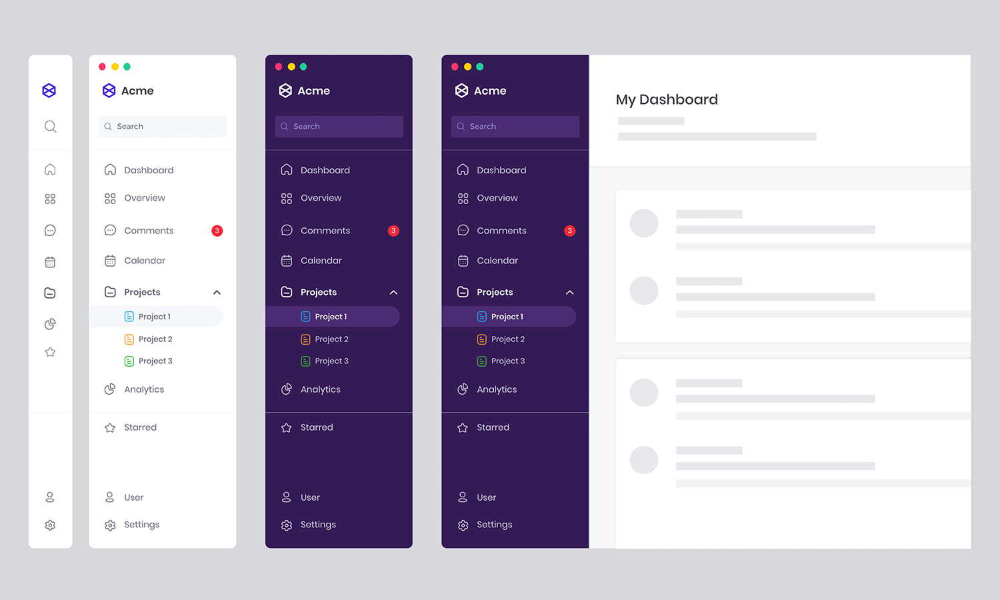
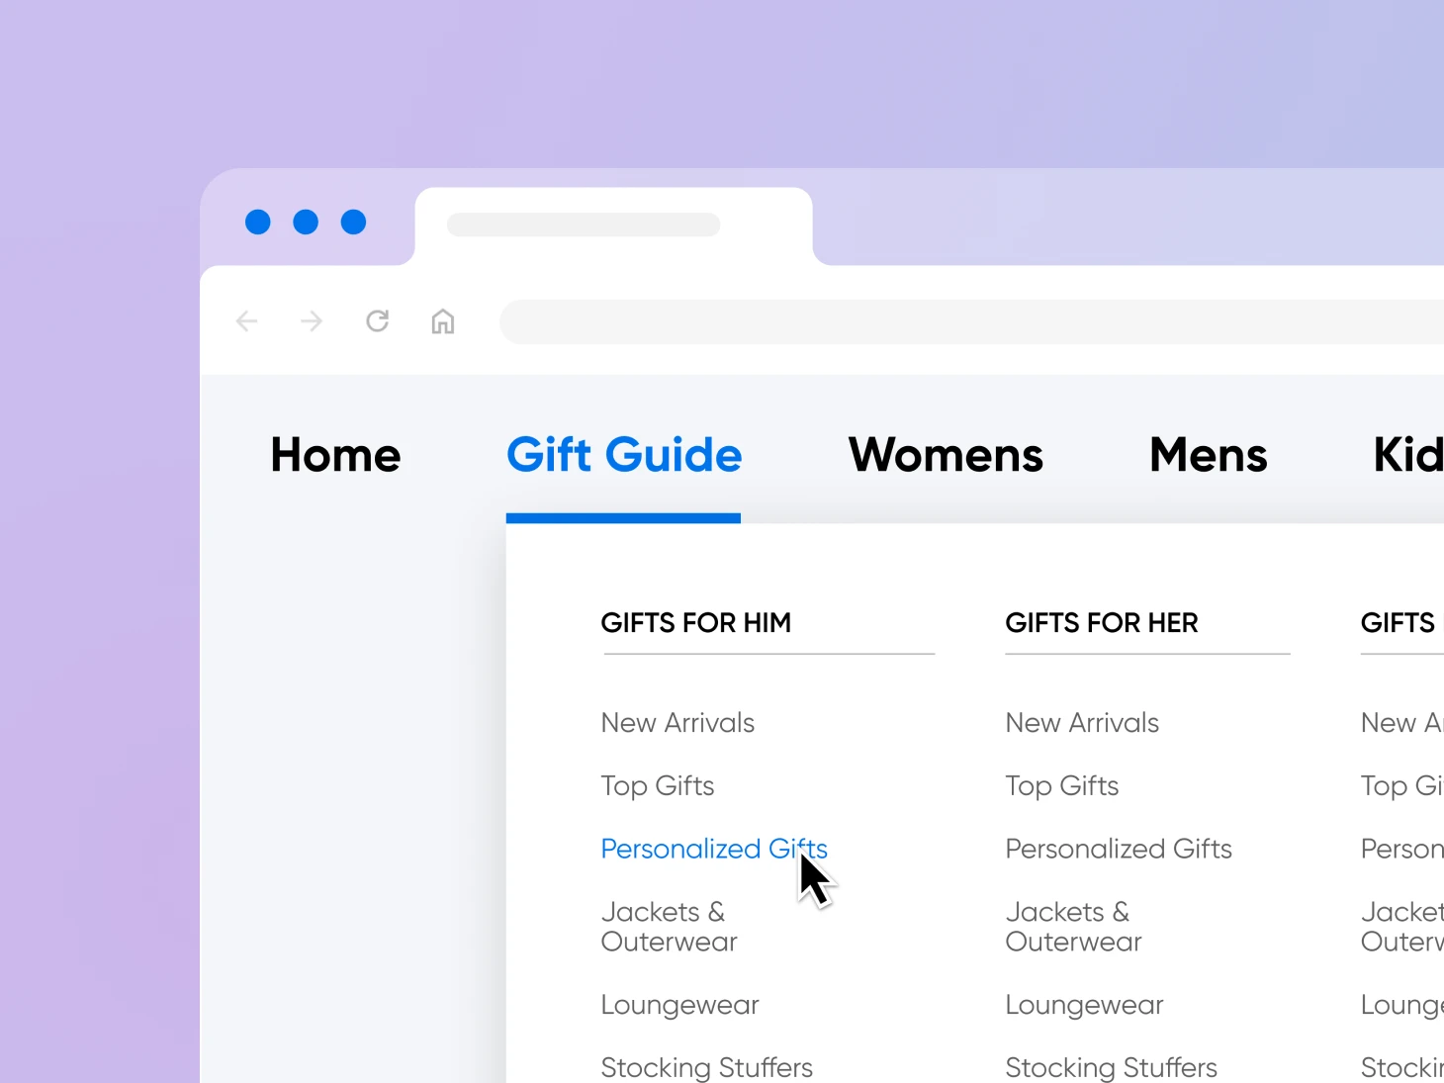
Building Navigation Menus
Navigation elements, typically created with <nav> and <a> tags, allow users to move between pages on a website. Well-designed navigation menus improve usability and help users find information quickly. CSS can be used to style navigation bars, add spacing through padding and margins, and create interactive hover effects using the :hover pseudo-class. A clear and consistent navigation structure is essential for user experience and overall site organization.

Slide 12
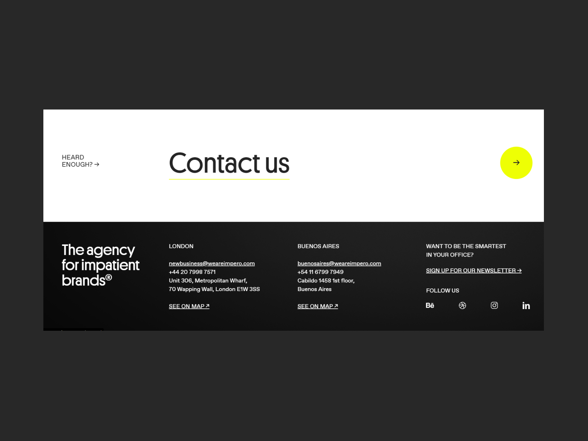

Footer Element
The <footer> element defines the footer section of a webpage or specific content sections like articles. It usually contains author information, copyright notices, and relevant links. Footers provide closure to the page content and can also serve as a secondary navigation area. Placing the footer appropriately ensures that users can easily access important information at the end of a page or section.

Slide 13
Contact Form PageContact Form Page
HTML forms, enclosed within <form> tags, are used to collect information from users, such as feedback, inquiries, or registration details. Forms can include text fields, radio buttons, textareas for long messages, and file upload options. Well-designed forms enhance usability and allow websites to interact with their users effectively. CSS can be applied to style form elements, making them visually appealing and consistent with the overall site design.

Slide 14
Media Queries & Responsive Design
Media queries in CSS allow developers to create responsive websites that adapt to various screen sizes and device types. A media query consists of an optional media type and media feature expressions, which define conditions under which specific CSS rules apply. By using media queries, websites can adjust layouts, font sizes, and element visibility, ensuring that the design remains functional and visually appealing on desktops, tablets, and smartphones.

Slide 15
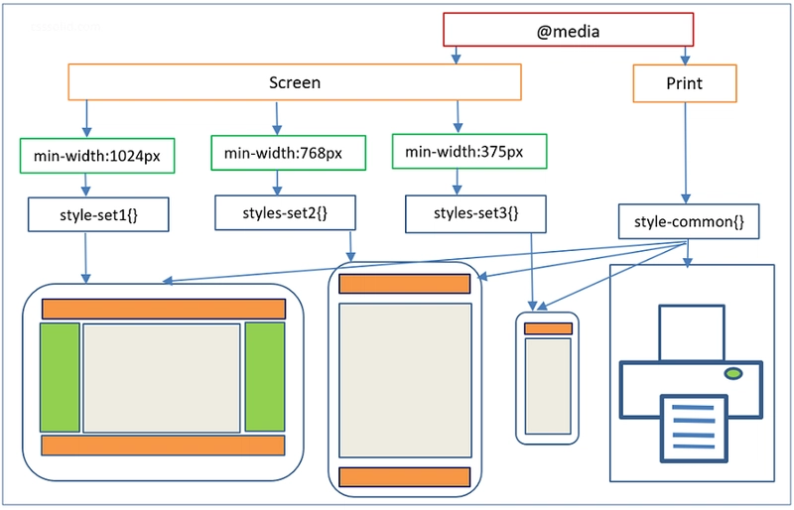
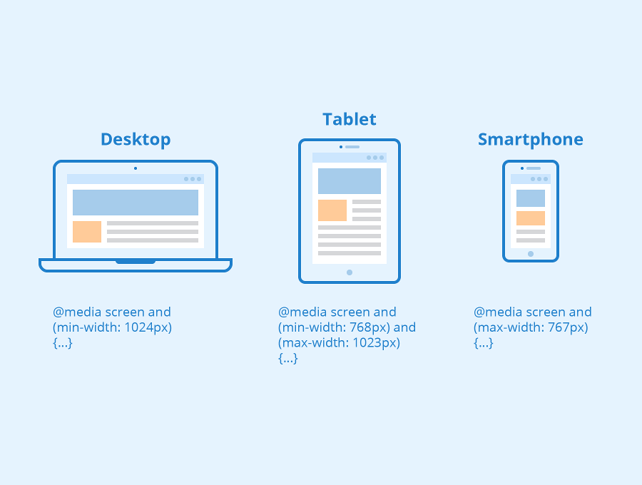

Slide 16
Code Refactoring
Refactoring involves improving the structure, readability, and performance of existing code without changing its functionality. In web development, this can include simplifying CSS selectors, combining Grid and Flexbox layouts for efficiency, and organizing stylesheets to avoid redundancy. Proper refactoring ensures faster page loads, easier maintenance, and better scalability for future enhancements.

Slide 17
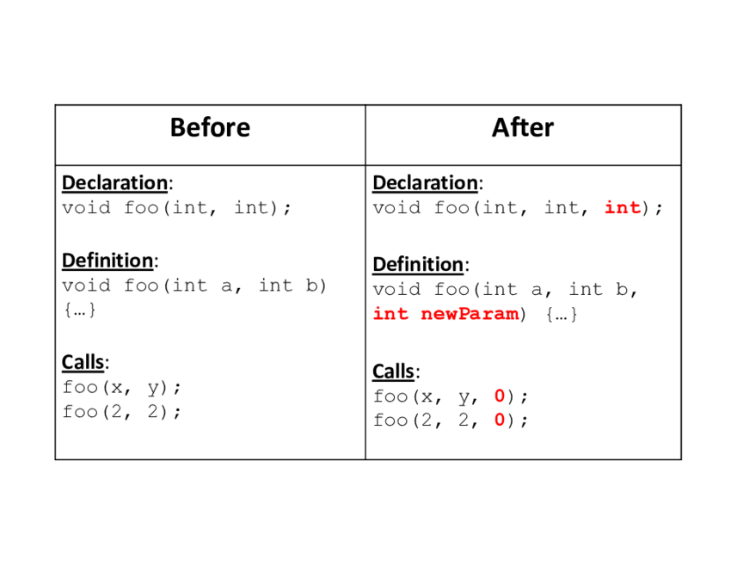
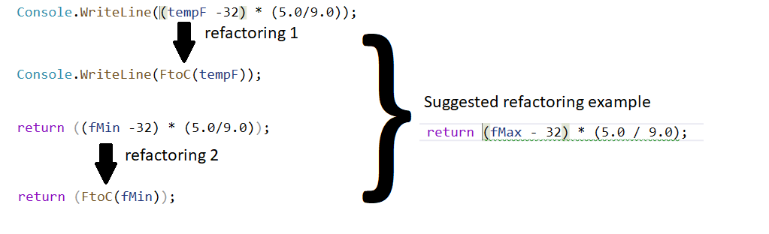

Slide 18
Summary & Key Takeaways
HTML provides the structure for content, while CSS enhances its appearance and layout. Core skills such as Flexbox, CSS Grid, custom fonts, and responsive design are essential for modern web development. Visual elements like images, parallax effects, navigation bars, footers, and forms improve usability and aesthetics. By combining these tools with good coding practices like refactoring, developers can create professional, functional, and visually appealing websites.

Slide 19
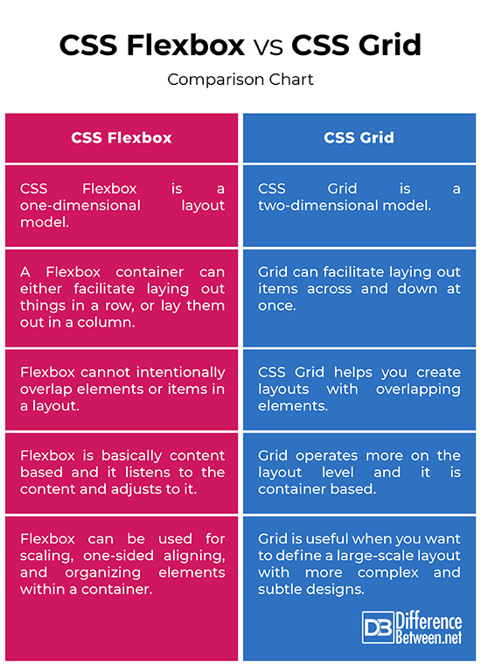
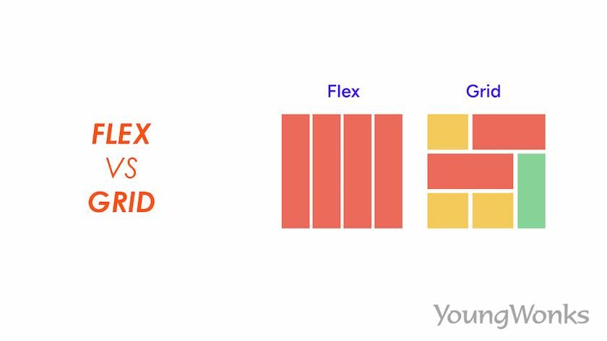
CSS Grid vs Flexbox
The CSS Grid tool is a powerful layout system that allows designers to create two-dimensional layouts with rows and columns. While it is similar to Flexbox in terms of arranging elements, CSS Grid offers much more utility for complex designs because it can handle both horizontal and vertical placement simultaneously. Flexbox, on the other hand, is primarily one-dimensional, focusing on either rows or columns. Combining both tools can give web developers maximum flexibility in creating responsive and visually appealing layouts

Slide 20
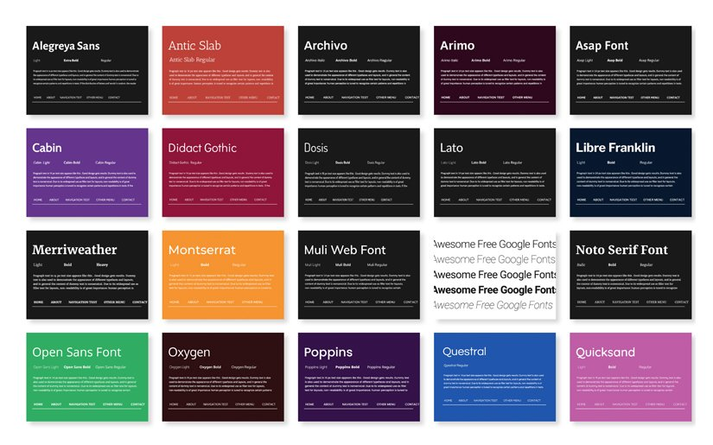
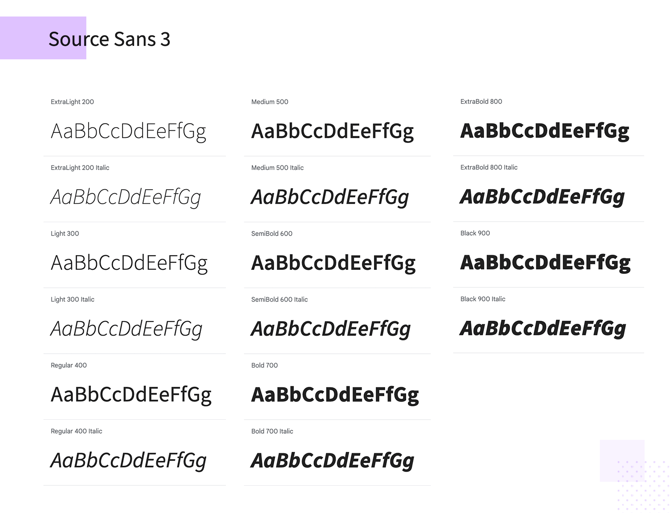
Custom Fonts in Web Design
Fonts play a critical role in determining the overall look and feel of a website. Using custom fonts helps align all elements harmoniously and enhances readability and aesthetics. Well-chosen fonts can strengthen a website’s branding, improve user experience, and make the application appear more professional. Fonts are applied through CSS and can be imported from sources like Google Fonts or added via @font-face.

Slide 21
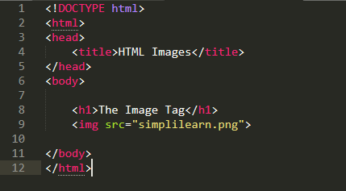
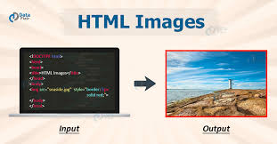
Adding Images to Webpages
Images can be added directly into the HTML document using the <img> tag or included as background images through CSS. Images enhance visual appeal, break up text content, and provide context or branding. Proper placement and sizing ensure that the webpage remains organized and responsive, while techniques like parallax effects can create a dynamic and engaging user experience.

Slide 22
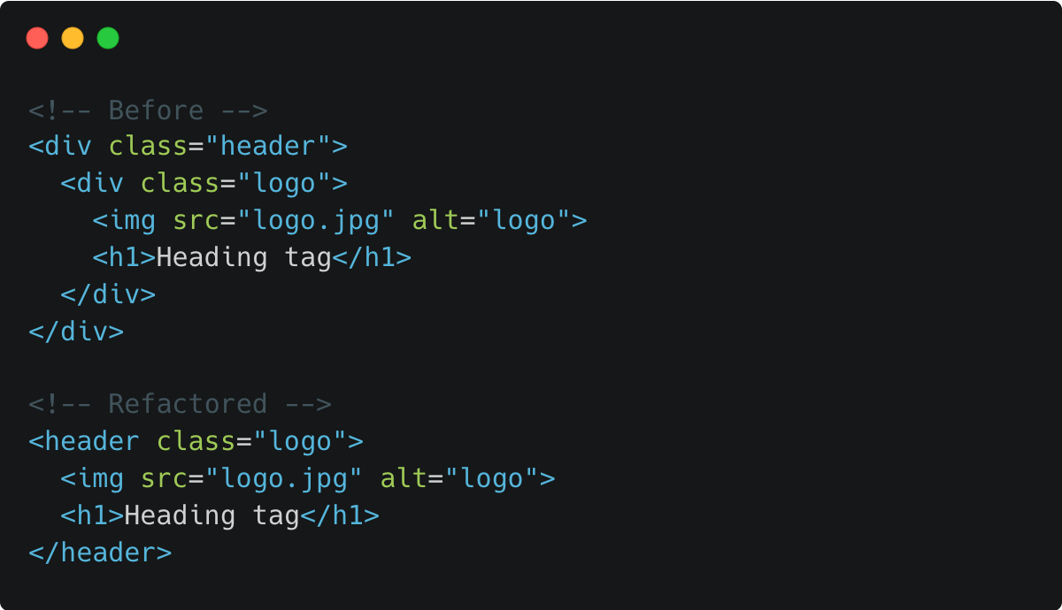
Refactoring CSS
Refactoring CSS involves improving the structure and specificity of selectors without changing the functionality of the website. It helps optimize the performance of the code, making it more readable, maintainable, and efficient. By organizing style files and reducing redundancy, developers can ensure faster loading times and easier future updates, leading to better performance and scalability of the website.

Slide 23
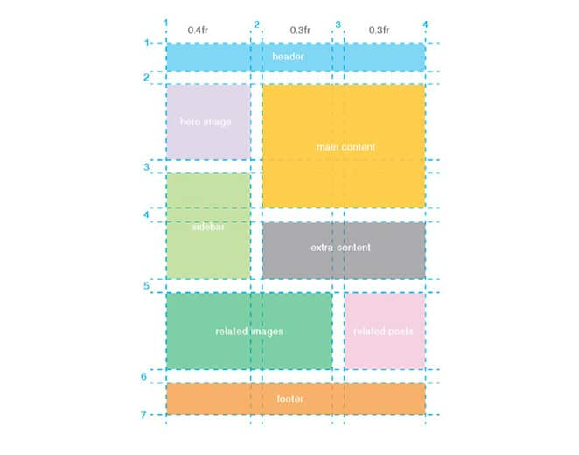
Combining CSS Grid and Flexbox
CSS Grid and Flexbox can be combined to achieve complex layouts and behaviors on a website. While Grid manages the overall two-dimensional structure, Flexbox can be used within individual grid items to align content more precisely. This combination allows designers to handle advanced layouts, maintain responsiveness, and create professional-looking pages that work seamlessly across different devices.

Slide 24
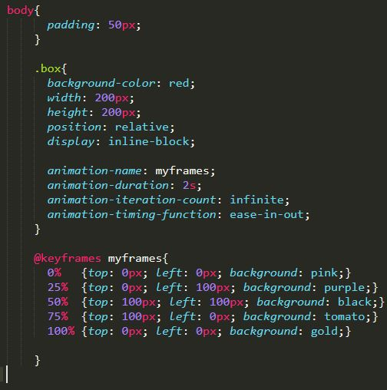
Implementing Animations
Animations can be implemented using CSS to enhance the interactivity of a website. These include hover effects, transitions, keyframe animations, and element transformations. Properly applied animations improve user experience by drawing attention to important elements, making interactions intuitive, and adding a dynamic feel to the website without overwhelming the content.

Slide 25
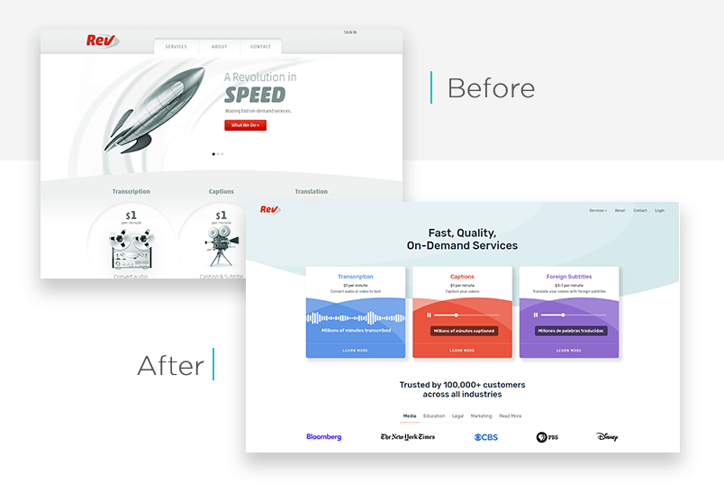
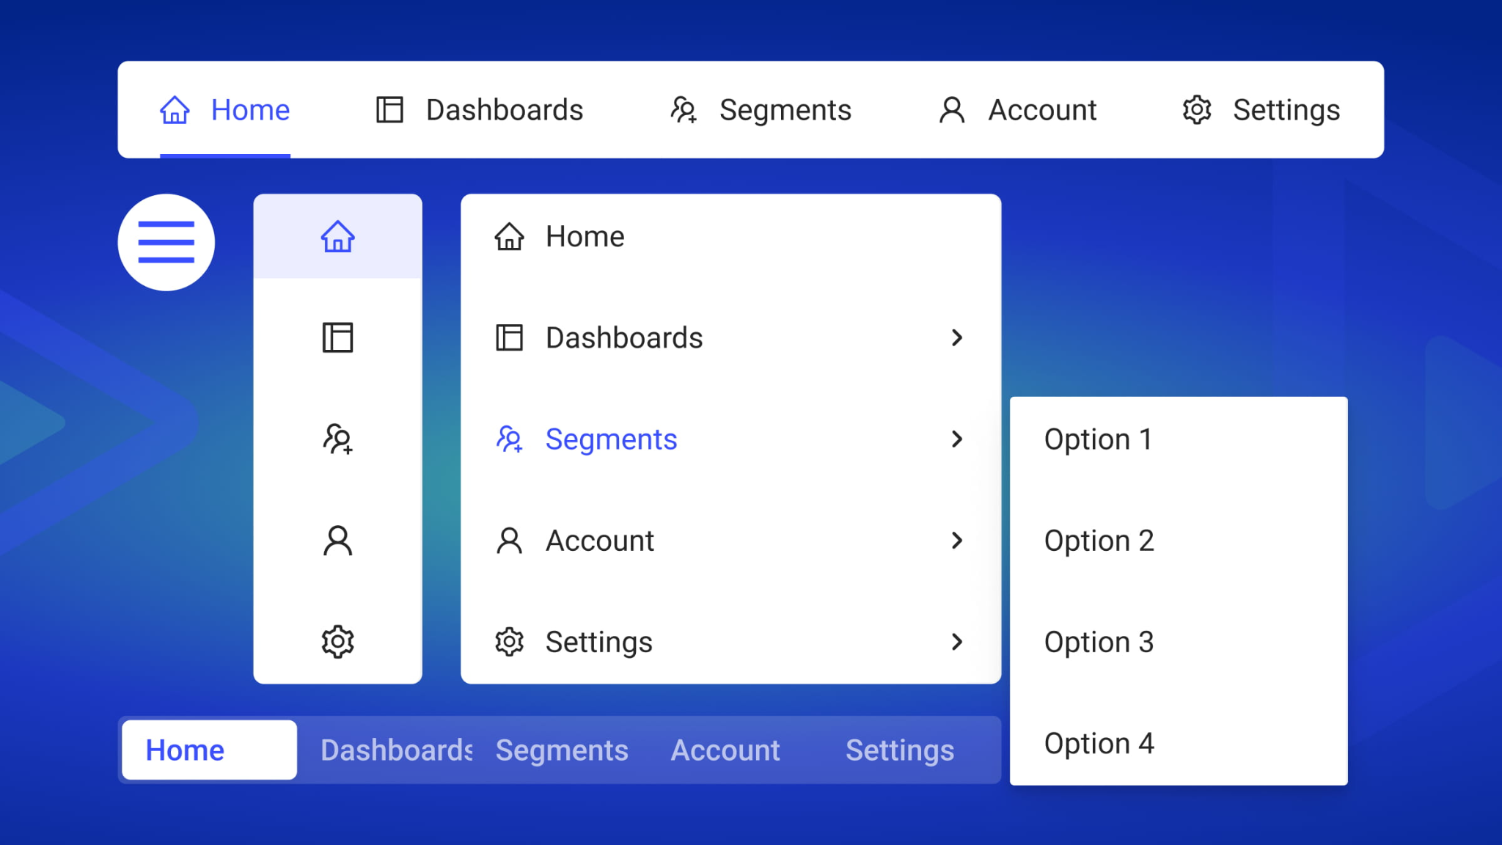
Refactoring Navigation Bars
Navigation bars are a key component of any website, and their CSS can be refactored for cleaner code and better maintainability. Organizing styles for navbars ensures consistency across all pages and improves the visual hierarchy of the menu. Refactoring also allows for easier implementation of hover effects, dropdowns, and responsive behavior on different screen sizes.

Slide 26

Parallax Images and Text Overlays
Parallax image features allow the background to move at a different speed than the foreground content, creating depth and visual interest. Developers can build these features from scratch using HTML and CSS. Text overlays can be added on top of parallax images to highlight key messages or headings, enhancing storytelling and ensuring that critical information remains visible and readable.

Slide 27
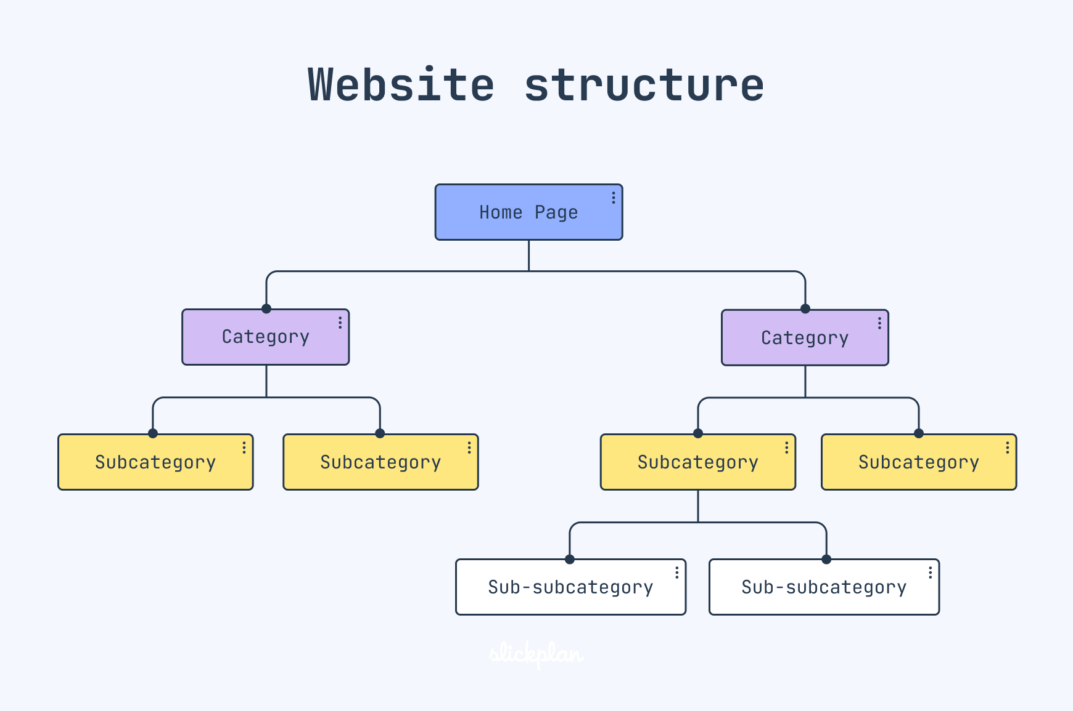
Adding HTML Structure to the Homepage
The homepage of a website is often the first point of interaction for users, and HTML structure plays a vital role in organizing content. Developers can add different types of elements, such as headings, paragraphs, images, forms, and buttons, to build a comprehensive layout. Proper structuring ensures accessibility, readability, and a visually appealing presentation, while CSS styling makes the homepage dynamic and engaging.

Slide 28
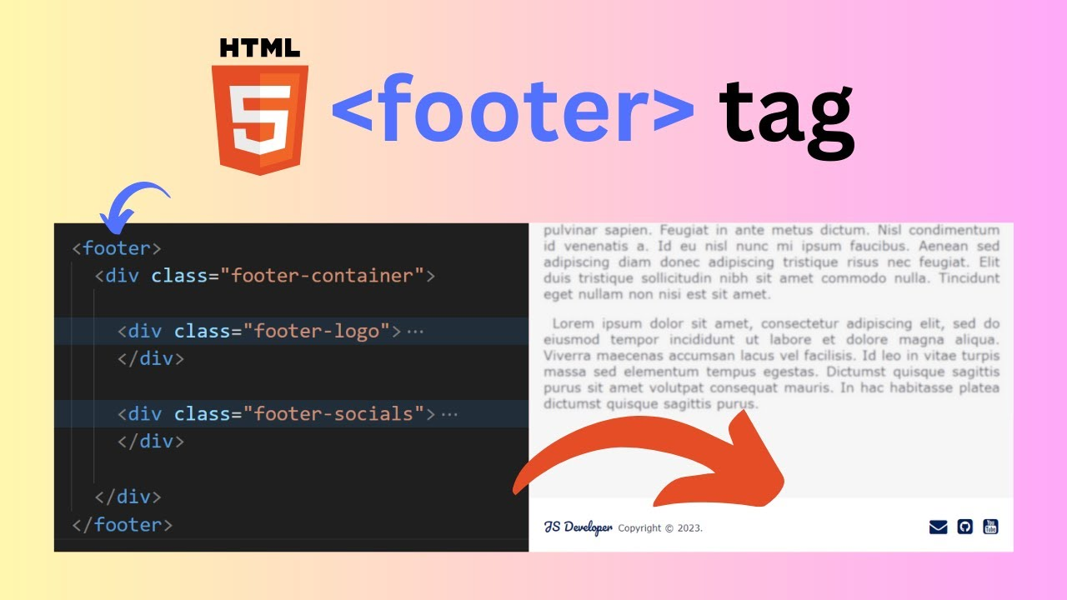
The Footer Element in HTML
The footer element is a structural component in HTML that is used to define the footer of a page, document, article, or any section of content. It helps organize information that is related to the content it belongs to, ensuring that important details are placed in a consistent and recognizable area on the webpage.The footer element is a structural component in HTML that is used to define the footer of a page, document, article, or any section of content. It helps organize information that is related to the content it belongs to, ensuring that important details are placed in a consistent and recognizable area on the webpage.

Slide 29
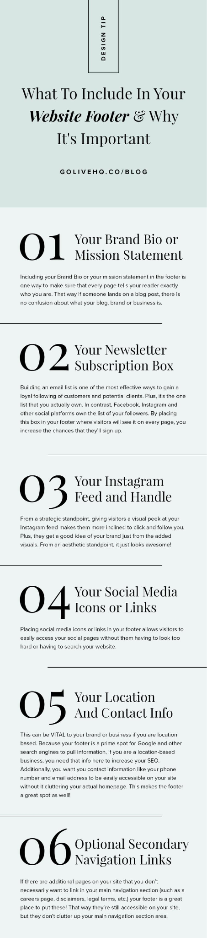
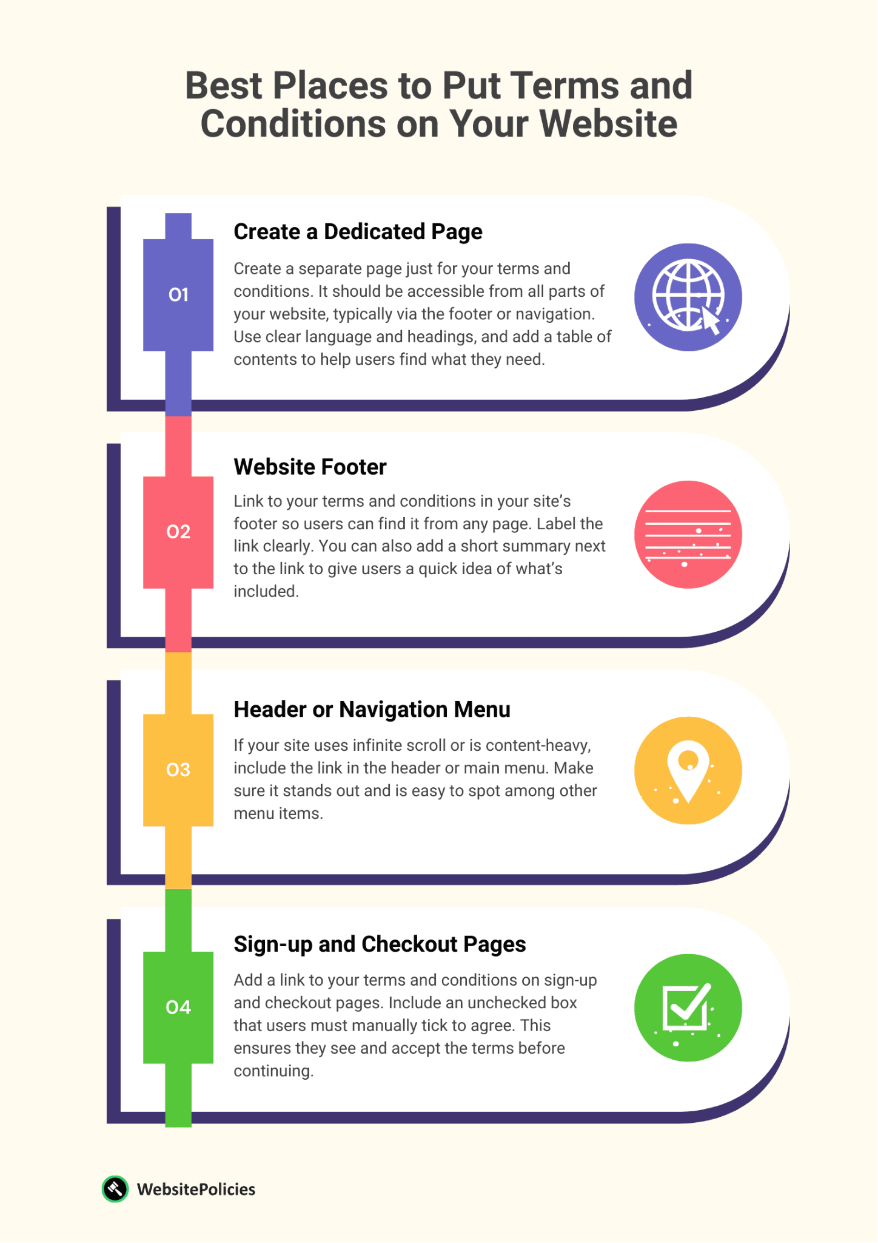
Purpose of a Footer
A footer typically contains information or navigational elements that are relevant to the parent element. This can include author details, copyright information, contact links, or quick navigation menus. By providing this information in the footer, users can easily access important details without disrupting the main content of the page.

Slide 30
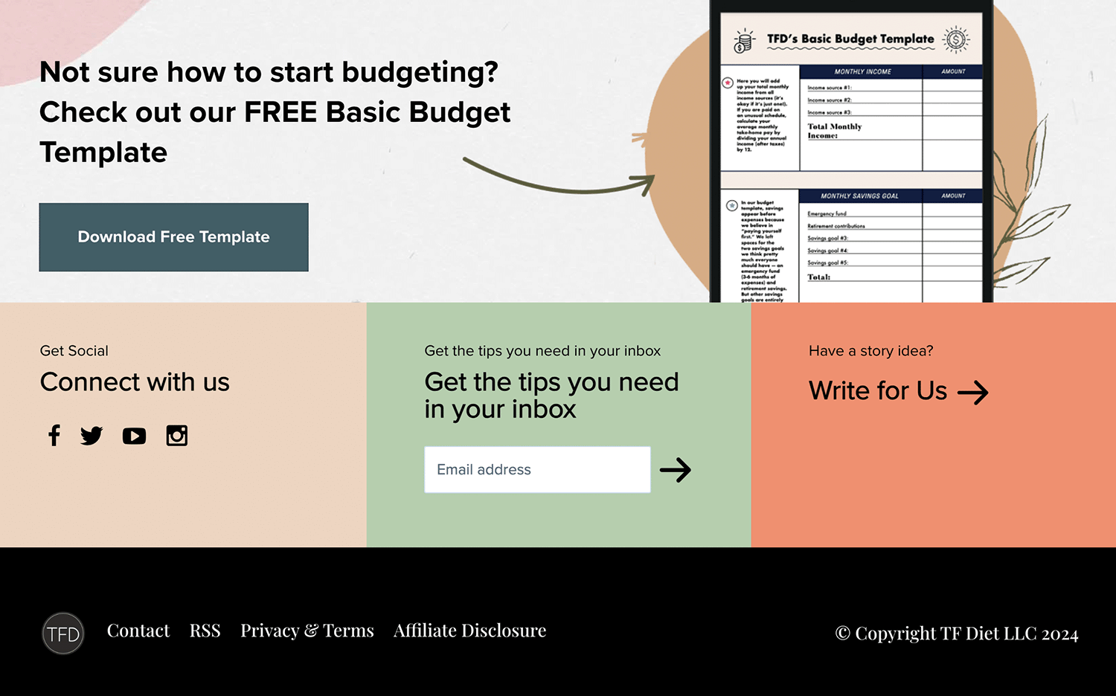
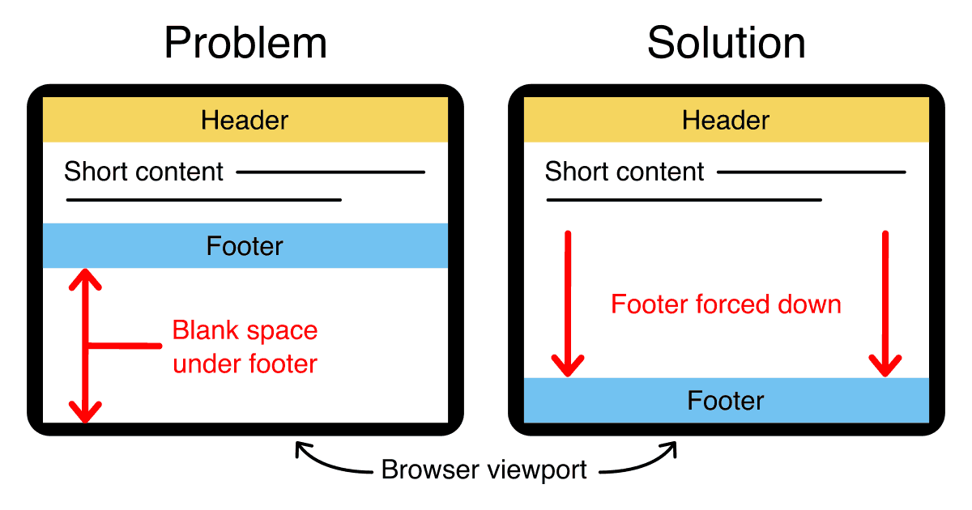
Placement of Footer
The most obvious place for a footer is at the bottom of a webpage. However, footers can also be used within sections, articles, or other content areas. The footer is always related to its parent element, meaning it defines information specifically for the section it belongs to, whether that is the entire page or just an individual article.

Slide 31
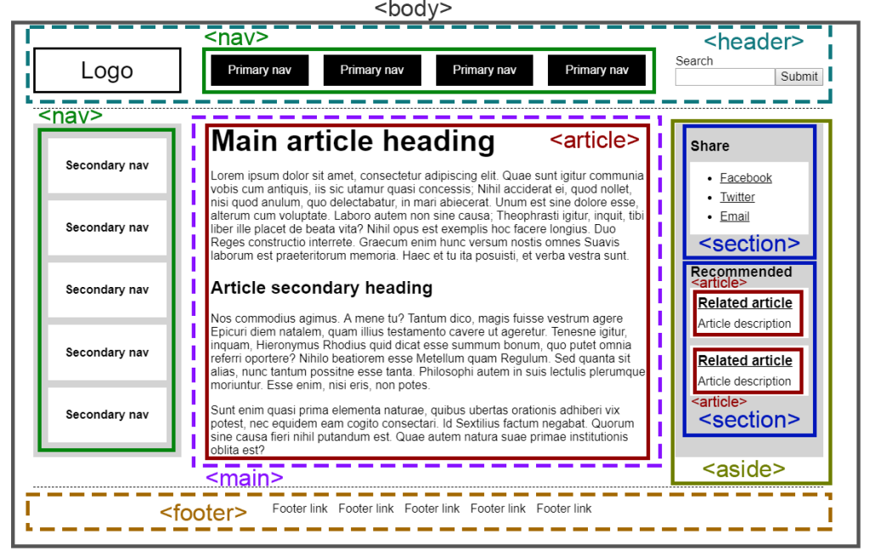
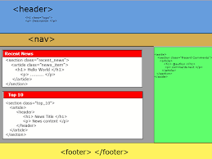
Footer Inside Sections and Articles
If a footer is placed inside an <article> element, it serves as the footer for that particular article only. Conversely, if a footer is placed as the last element of the main content, it functions as the footer for the entire page. This flexibility allows developers to provide relevant information at both section and page levels.

Slide 32

Content of a Footer
Most footers contain headings that divide different parts of the footer. These headings often organize links in a list format, making navigation easier for users. Common elements include copyright notices, contact information, social media links, and other related resources that help users access essential information quickly.

Slide 33
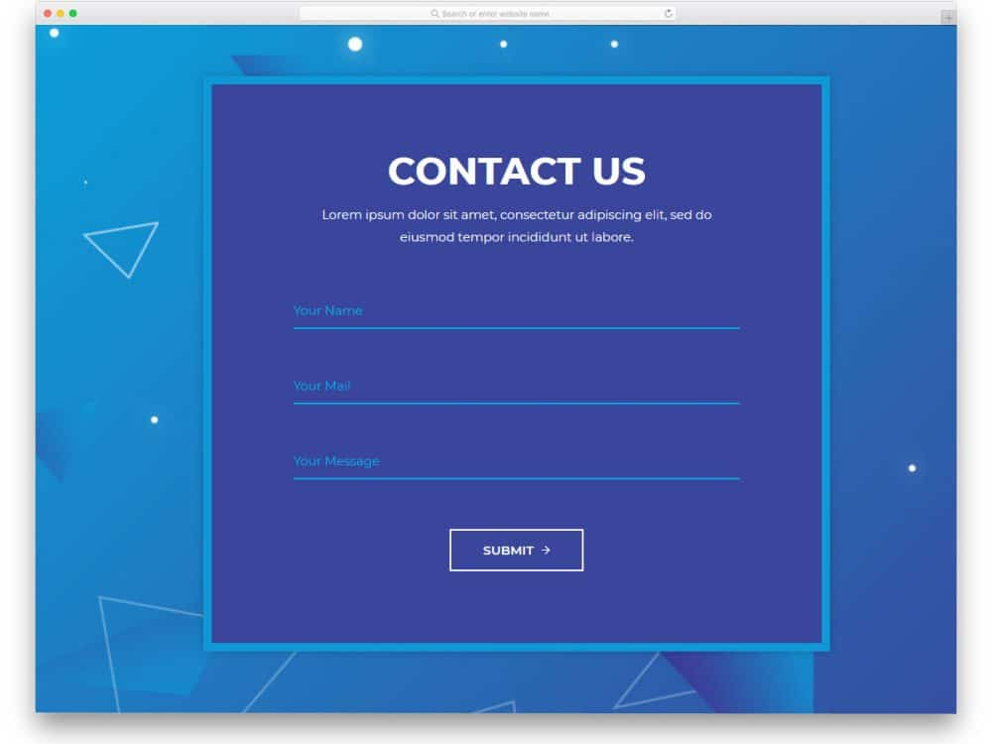
HTML Contact Form Page
One of the most important and useful pages on any website is the HTML contact form page. Contact forms allow websites to interact with users by collecting information, feedback, or inquiries. This page is essential for communication between the website owner and visitors, making it a critical feature for professional websites.

Slide 34
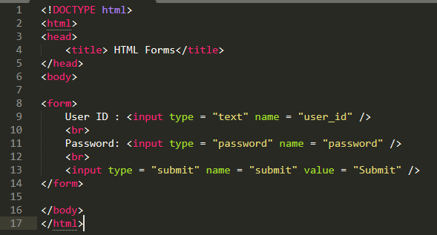
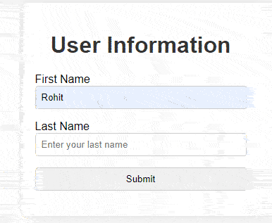
Enclosing Forms with the FORM Tag
HTML forms must be enclosed within the <form> tags. This element defines the form structure and contains all input fields, buttons, and other interactive components. Using the <form> tag ensures that the website can collect and submit user input correctly and that the form is recognized by browsers and backend systems.

Slide 35
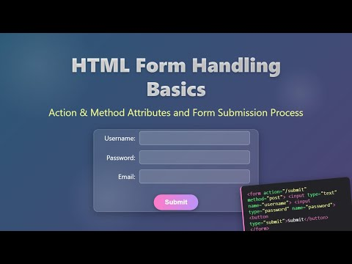
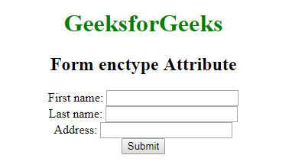
Parameters in FORM Tags
HTML forms provide several attributes that control their behavior. Parameters such as action, method, and enctype define how and where the form data is sent. These options allow developers to customize form behavior for tasks like sending data to a server, uploading files, or handling form submissions efficiently.

Slide 36
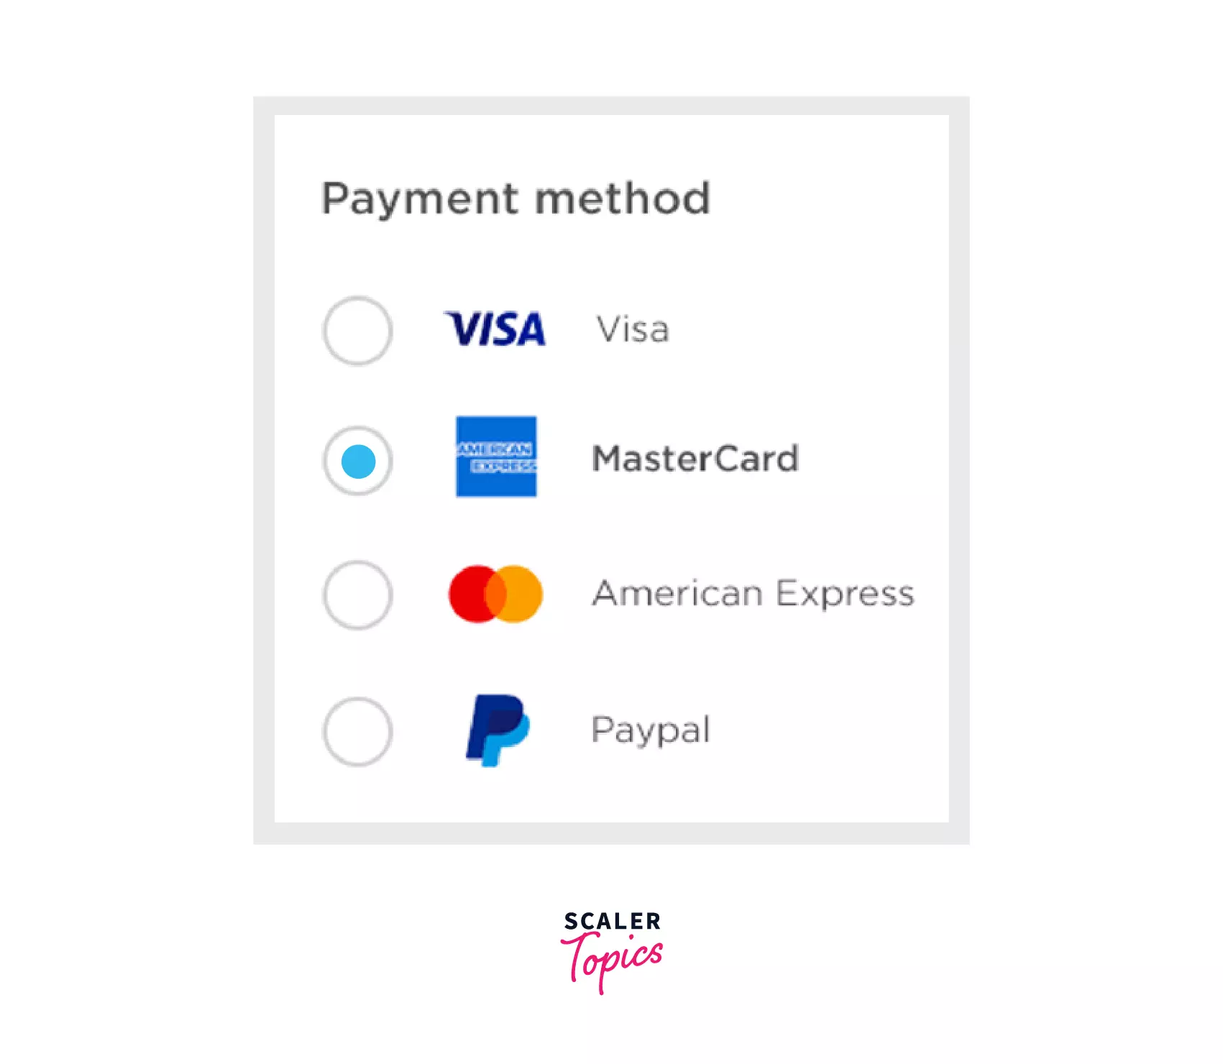
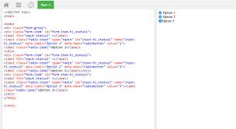
Radio Buttons for Short Lists
When a form requires users to select one option from a small set of choices, radio buttons are ideal. Radio buttons ensure that only one option can be selected at a time, making them perfect for single-choice questions such as selecting gender, subscription plans, or preferences. Proper labeling ensures accessibility and improves user experience.

Slide 37
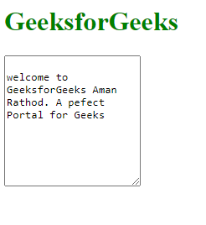
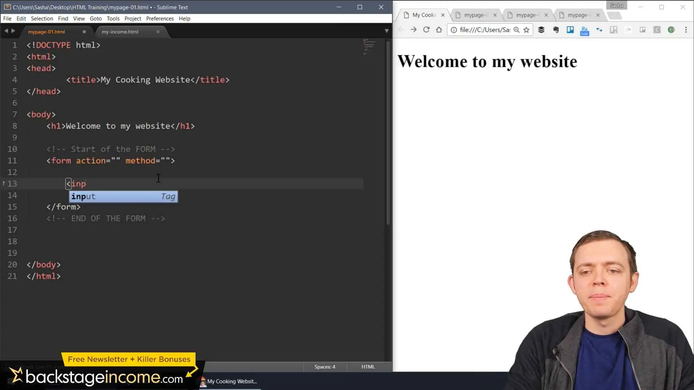
Multi-line Text Fields
For collecting larger blocks of text, such as messages, feedback, or detailed responses, the multi-line text field, known as a textarea, is more suitable than a simple input field. This allows users to enter and review longer content comfortably, improving the effectiveness of contact forms for user communication.

Slide 38
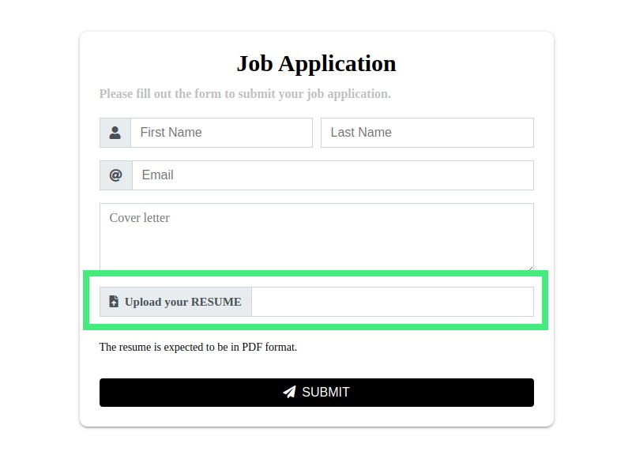
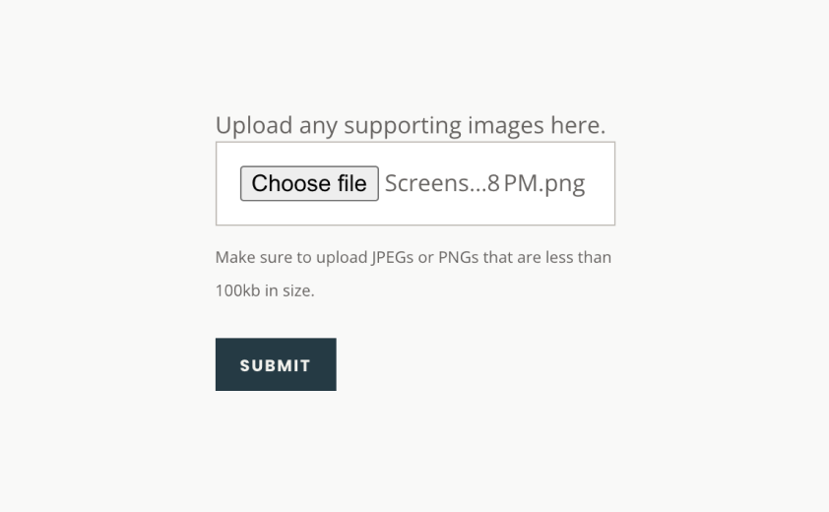
Allowing File Uploads
Sometimes, it is necessary to allow users to upload files through a form. This can include images, documents, or other attachments. File input fields, created with <input type="file">, enable this functionality. Proper validation and instructions ensure that users upload appropriate file types safely and efficiently.

Slide 39
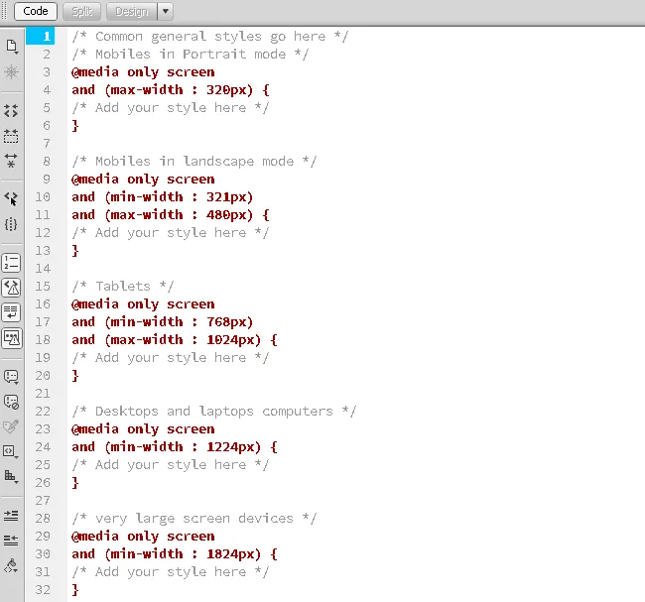
Using Media Queries for Responsive Design
Media queries are an essential CSS tool that allows developers to modify a website or application based on the type of device being used. They enable websites to adapt layouts, font sizes, and visibility of elements to ensure optimal viewing across desktops, tablets, and smartphones.

Slide 40
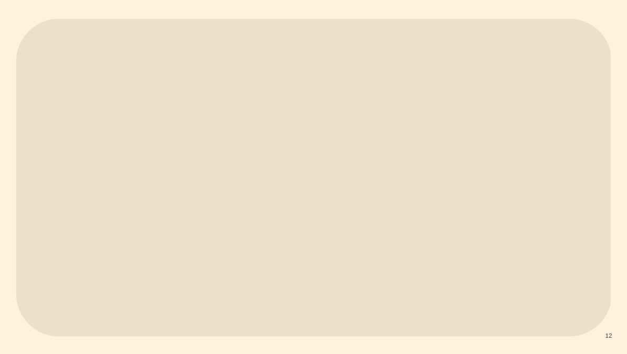
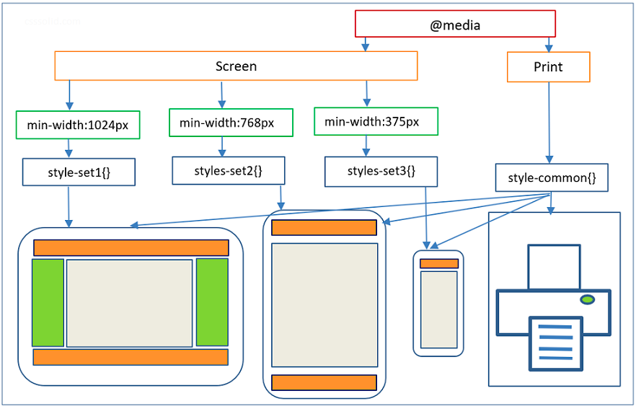
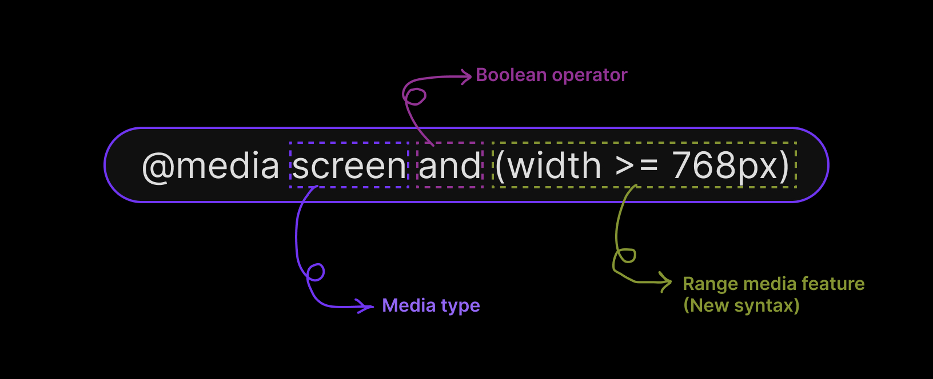
Components of Media Queries
A media query consists of an optional media type, such as screen or print, and any number of media feature expressions, like max-width or orientation. These expressions define the conditions under which specific CSS rules are applied, allowing developers to target specific devices or screen sizes effectively.

Slide 41
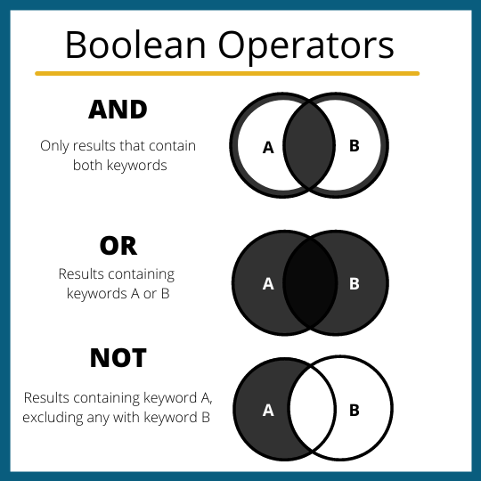
Logical Operators in Media Queries
Multiple media queries can be combined using logical operators such as and, or, and not. This allows developers to create complex conditions for styling elements differentlnd adaptive web designs.y based on multiple device features simultaneously. Media queries are case-insensitive and provide powerful tools for creating fully responsive a

Slide 42


